Slide 1

Leo’s Stock Exchange

Slide 2
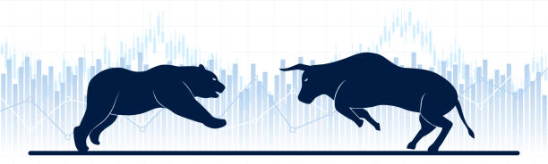
LEO’S STOCK EXCHANGE

